Slide 1
Custom Cars
By Sarai De Leon

Slide 2
Overview
What is the app?
How did you go about building it?
What was your biggest challenge and how did you overcome?
What was pivotal to the functioning of your application?
Did it flow logically?
Why did you build the app this way?
Demonstration of the app
Were client requirements met?
What improvements would you make next?

Slide 3
What is the app?
Custom Cars for manufacturing client
5 Suppliers
Each providing different car parts
Each car part has a unique properties: serial number, quantity, status
Client needs:
Add new car part (tire, break, trim) with specific supplier
Add/update supplier info (name, email, phone)
Update car part by unique properties (quantity in stock, price per item)
Add new item to individual parts inventory
Delete individual items from inventory while updating status as “used” without removing from database
Items can only be deleted if they are lost or defective
Search for low inventory (any item with less than 50 remaining in stock)
Add new orders with start date and completion date while automatically decreasing inventory by order start date and while marking parts as “used” in full inventory
Delete orders (should mark any previously associated parts as unused)
Update quantity in stock of any part

Slide 4
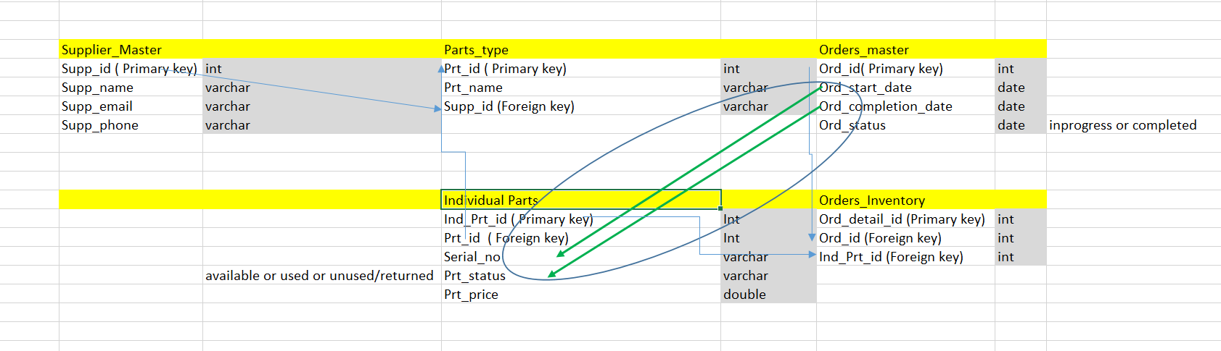
How did you go about building it?

Slide 5
Biggest Challenges
Challenge:
Troubleshooting to find errors
Changing variable names mid-project
Annotations
Poor Time Management
Resisting urge to treat project as puzzle
How did you overcome?
Google and YouTube
Error logs and Debugging
Feedback from teacher, TAs, and tutors

Slide 6
What was pivotal to the functioning of your application?
Following instructions during building phase
Understanding errors
Keeping it simple per requirements

Slide 7
Did it flow logically? Why did you choose this Structure?
Add Supplier
Add Part Type
Add Individual Item
Add New Order

Slide 8
Demonstration of the App…

Slide 9
Were client requirements met?
Meets all client requirements
Employs TDD in every phase of architecting the project
Provides highly usable documentation
Normalizes all database tables to 3rd normal form
Employs at least 1 join

Slide 10
What improvements would you make next?
Follow TDD (Test-driven development) Philosophy
Zoom out periodically to review client requirements
Time management per phase
Design

